Slide 1

End of KS3 assessments
Projects: Project 1

Slide 2
Objectives
In this lesson, you will demonstrate:
your ability to write a program in Python
your understanding of testing
the importance of versioning.

Slide 3
The project
You will be using the Python programming skills you have learnt to develop two computer programs over the next six weeks.
First you will spend three lessons coding an arithmetic quiz. Then you will spend three lessons coding a password strength program.
You will code a section of each program and then debug and test it before moving on to the next section. This is the iterative approach to project development.

Slide 4
Debugging
When you run each section of your program for the first time, it will probably contain errors. These errors are known as bugs.
The bugs occur because Python cannot understand the program or because it is unable to carry out the instructions.
You will usually be given a clue about the cause of the bug and you will need to read through the code carefully to work out how to fix or debug it.

Slide 5
Testing
When each section of your program is working without bugs, you need to test it to make sure it works as it should.
To do this, you need to test the program with:
normal data
abnormal data
boundary data.

Slide 6
Testing
Normal data is data you would expect to see if the program was being used normally.
For example: 8 is entered in response to the question What is 3 + 5?
Abnormal data is data you would not expect to see if the program was being used normally.
For example: Do not know is entered in response to the question What is 3 + 5?
Boundary data is data that checks that answers just within a range are accepted and those just outside a range are not.
For example: if we wanted to check to see if someone was 10 or older, we would use 9 (just outside the range) and 10 (just inside the range) as the test values.

Slide 7
Test tables
When testing a program, you must record what you do in a test table and provide accompanying evidence.
You will focus on testing your programs with normal data so your test tables and evidence will look something like this:
Evidence:
What is 9 + 1 ?
Enter the answer: 10
Well done.
What is 5 + 5 ?
Enter the answer: 7
That is not right.
What is 10 + 1 ?
Enter the answer:
Test data | Reason | Expected outcome | Actual outcome | Actions
What is 9 + 1? 10 | Will I get the expected response to the correct answer? | Well done. | Well done. | None required
What is 5 + 5? 7 | Will I get the expected response to an incorrect answer? | That is not right. | That is not right. | None required

Slide 8
Keeping versions
It is important to save a version of a program before you test and debug it.
Saving multiple versions of a program means you can return to a working version if something goes wrong.
Remember to use logical file names, so that you know which version of the program is which.

Slide 9
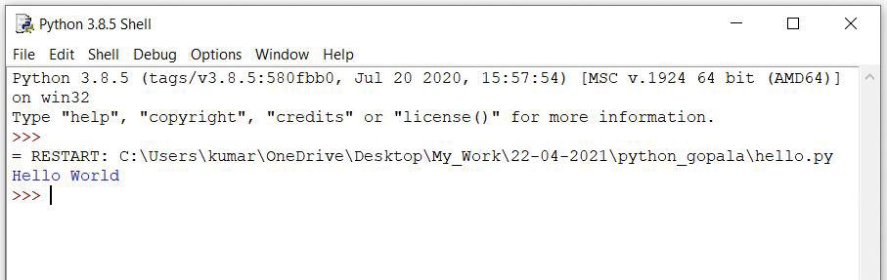
IDLE
IDLE is Python’s standard development environment.
When IDLE is loaded, it opens the Python shell. This is where the output from a program appears.

Slide 10
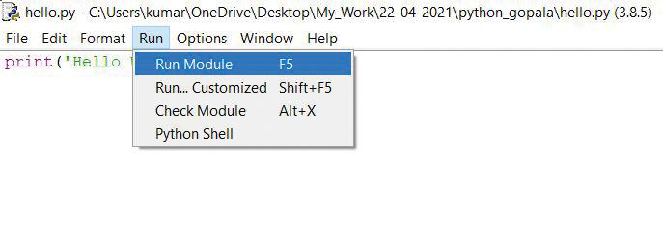
IDLE
To start coding a new program, click on ‘File’ and ‘New File’. This will open a new window where you can type your code.
To save a program, click on ‘File’ and ‘Save As…’, give the file a .py extension and then click ‘Save’.
When you want to run your code, click on ‘Run’ and ‘Run Module’.
Watch Video 1.1

Slide 11

Project 1.1: Arithmetic quiz

Slide 12
Project 1.2: Password strength program

